Slide 1
ARM Architecture

Slide 2

ARM history
The ARM processor is a key component of many successful 32-bit embedded systems. These processors widely used in mobile phones, handled organizers and multitude of other everyday portable consumer devices.
– The first commercial RISC implemenation
– Match the needs for generalized SoC for reasonable
power, performance and die size
• 1990 ARM (Advanced RISC Machine), owned by
Acorn, Apple and VLSI

Slide 3
Why ARM?
• One of the most licensed and thus widespread
processor cores in the world
– Used in PDA, cell phones, multimedia players,
handheld game console, digital TV and cameras
– ARM7: GBA, iPod
– ARM9: NDS, PSP, Sony Ericsson, BenQ
– ARM11: Apple iPhone, Nokia N93, N800
– 90% of 32-bit embedded RISC processors till 2009
•

Slide 4

Why ARM here?
• ARM is one of the most licensed and thus widespread processor cores in the world
• Used especially in portable devices due to low power consumption and reasonable performance (MIPS / watt)
• Several interesting extensions available or in development like Thumb instruction set and Jazelle Java machine
3

Slide 5
RISC design
The ARM core uses RISC architecture.
The design philosophy aimed at delivering the following.
a high instruction throughput
an excellent real-time interrupt response
Single cycle execution at a high clock speed
Intelligence in software rather than hardware
Provide greater flexibility on reducing the complexity of instructions.

Slide 6

ARM is a RISC
• RISC: simple but powerful instructions that
execute within a single cycle at high clock speed.
• Four major design rules:
– Instructions: reduced set/single cycle/fixed length
– Pipeline: decode in one stage/no need for microcode
– Registers: a large set of general-purpose registers
– Load/store architecture: data processing instructions
apply to registers only; load/store to transfer data
from memory
• Results in simple design and fast clock rate

Slide 7
Naming ARM
• ARMxyzTDMIEJFS
– x: series
– y: MMU
– z: cache
– T: Thumb
– D: debugger
– M: Multiplier
– I: EmbeddedICE (built-in debugger hardware)
– E: Enhanced instruction
– J: Jazelle (JVM)
– F: Floating-point
– S: Synthesizible version (source code version for EDA
tools)

Slide 8
Popular ARM architectures
• ARM7TDMI
– 3 pipeline stages (fetch/decode/execute)
– High code density/low power consumption
– One of the most used ARM-version (for low-end
systems)
– All ARM cores after ARM7TDMI include TDMI even if
they do not include TDMI in their labels
• ARM9TDMI
– Compatible with ARM7
– 5 stages (fetch/decode/execute/memory/write)
– Separate instruction and data cache
• ARM11

Slide 9
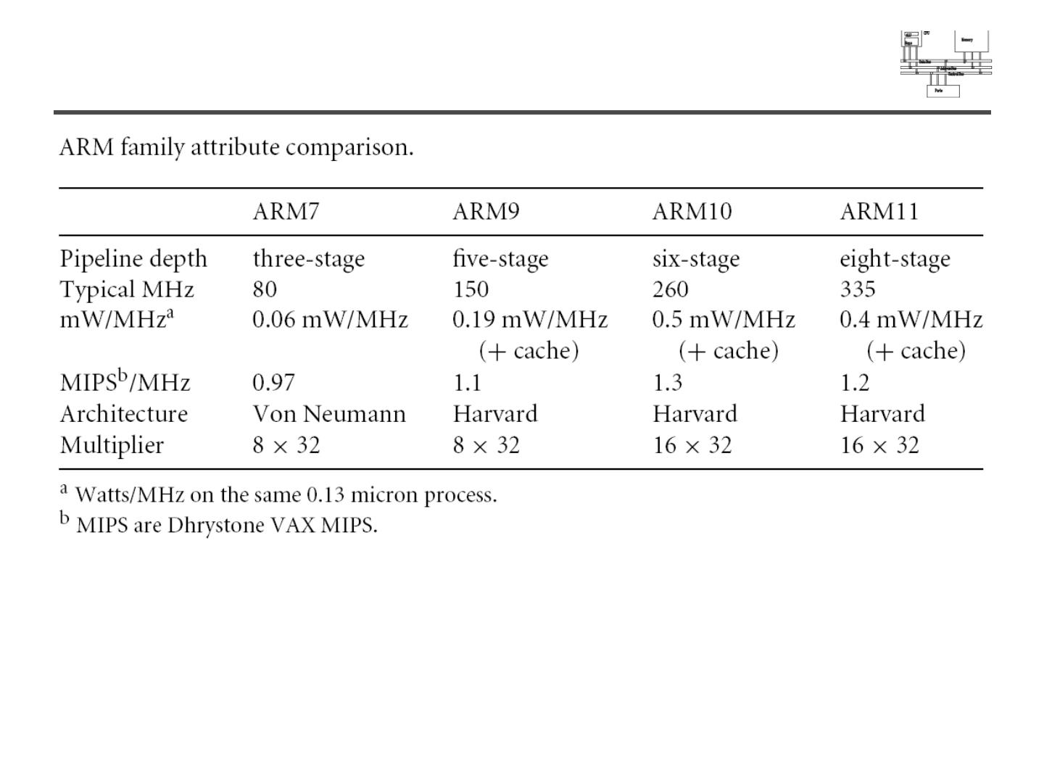
ARM family comparison
year
1995
1997
1999
2003

Slide 10
ARM features
• Different from pure RISC in several ways:
– Variable cycle execution for certain instructions:
multiple-register load/store (faster/higher code density)
– Inline barrel shifter leading to more complex instructions: it is a hardware component that preprocesses one of the input registers before it is used by an instruction.
– Thumb 16-bit instruction set: 30% code density improvement
– Conditional execution: improve performance and code density by reducing branch
– Enhanced instructions: DSP instructions —the enhanced digital signal processor (DSP) instructions were added to the
standard ARM instruction set to support fast 16×16-bit multiplier operations and saturation.

Slide 11
Memory Access
The ARM7TDMI core has a Von Neumann architecture, with a single 32-bit data bus carrying both instructions and data.
Only load, store, and swap instructions can access data from memory.
Data can be:
• 8-bit (bytes)
• 16-bit (halfwords)
• 32-bit (words).
Words must be aligned to 4-byte boundaries. Halfwords must be aligned to 2-byte boundaries.

Slide 12
Architecture
The ARM7TDMI processor has two instruction sets:
• 32-bit ARM instruction set
•16-bit Thumb instruction set.
Instruction compression
Microprocessor architectures traditionally have the same width for instructions and data.
In comparison with 16-bit architectures, 32-bit architectures exhibit higher performance when manipulating 32-bit data, and can address a large address space much more efficiently.
16-bit architectures typically have higher code density than 32-bit architectures, but approximately half the performance.
Thumb implements a 16-bit instruction set on a 32-bit architecture to provide:
• higher performance than a 16-bit architecture
• higher code density than a 32-bit architecture.

Slide 13
The Thumb instruction set
Thumb instructions are each 16 bits long, and have a corresponding 32-bit ARM instruction that has the same effect on the processor model
On execution, 16-bit Thumb instructions are transparently decompressed to full 32-bit ARM instructions in real time, without performance loss.
Thumb has all the advantages of a 32-bit core:
• 32-bit address space
• 32-bit registers
• 32-bit shifter, and Arithmetic Logic Unit (ALU)
• 32-bit memory transfer.
Jazelle cores can also execute Java bytecode

Slide 14
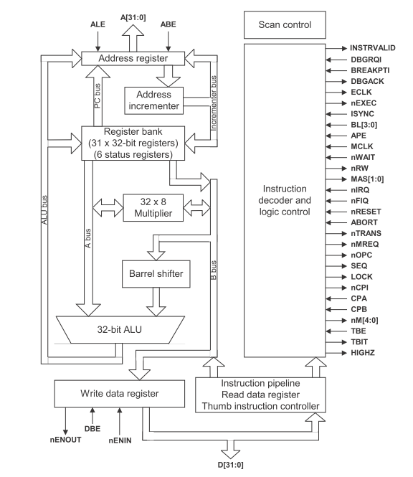

Slide 15
ARM7TDMI Block Diagram

Slide 16
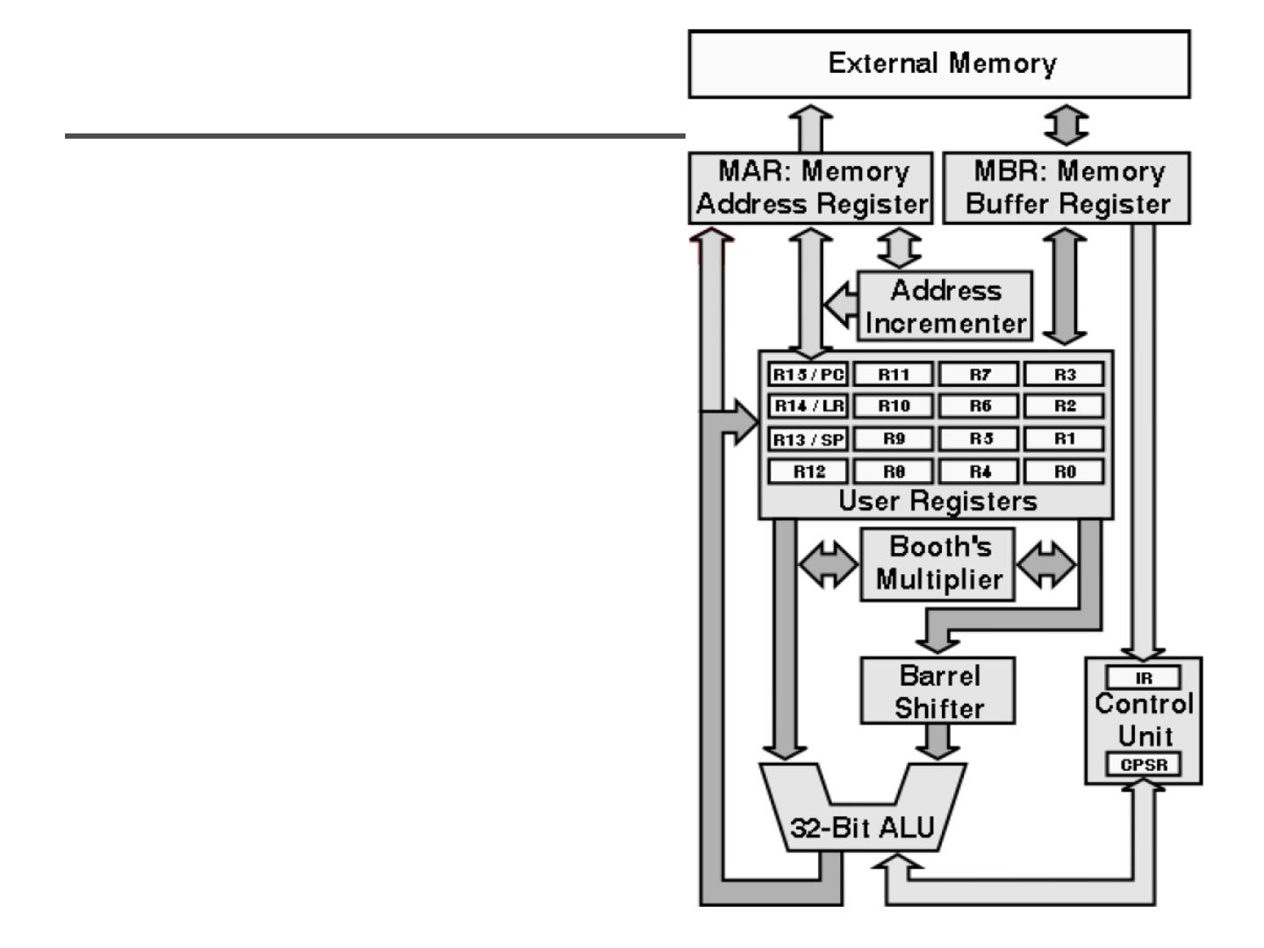
ARM architecture
• Load/store
architecture
• A large array of
uniform registers
• Fixed-length 32-bit
instructions
• 3-address instructions

Slide 17
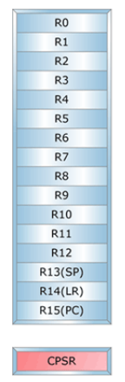
Registers
• Only 16 registers are visible to a specific mode.
A mode could access
– A particular set of r0-r12
– r13 (sp, stack pointer)
– r14 (lr, link register)
– r15 (pc, program counter)
– Current program status register (cpsr)
– The uses of r0-r13 are orthogonal
One additional register—a saved copy of Current Program Status Register (CPSR) that's called SPSR (Saved Program Status Register)—is for exception mode only.

Slide 18
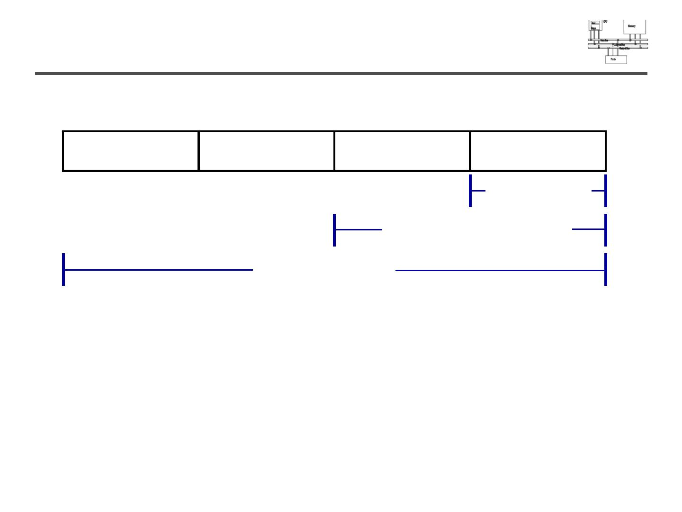
General-purpose registers
31
24 23
16 15
8 7
0
8-bit Byte
16-bit Half word
32-bit word
• 6 data types (signed/unsigned)
• All ARM operations are 32-bit. Shorter data
types are only supported by data transfer
operations.

Slide 19
Special Registers
Special function registers:
PC (R15): Program Counter. Any instruction with PC as its destination register is a program branch
LR (R14): Link Register. Saves a copy of PC when executing the BL instruction (subroutine call) or when jumping to an exception or interrupt routine
- It is copied back to PC on the return from those routines
SP (R13): Stack Pointer. There is no stack in the ARM architecture. Even so, R13 is usually reserved as a pointer for the program-managed stack
CPSR : Current Program Status Register. Holds the visible status register
SPSR : Saved Program Status Register. Holds a copy of the previous status register while executing exception or interrupt routines
- It is copied back to CPSR on the return from the exception or interrupt
- No SPSR available in User or System modes
Notes:
The Programmers Model can be split into two elements - first of all, the processor modes and secondly, the processor registers. So let’s start by looking at the modes.
Now the typical application will run in an unprivileged mode know as “User” mode, whereas the various exception types will be dealt with in one of the privileged modes : Fast Interrupt, Supervisor, Abort, Normal Interrupt and Undefined (and we will look at what causes each of the exceptions later on).
NB - spell out the word FIQ, otherwise you are saying something rude in German!
One question here is what is the difference between the privileged and unprivileged modes? Well in reality very little really - the ARM core has an output signal (nTRANS on ARM7TDMI, InTRANS, DnTRANS on 9, or encoded as part of HPROT or BPROT in AMBA) which indicates whether the current mode is privileged or unprivileged, and this can be used, for instance, by a memory controller to only allow IO access in a privileged mode. In addition some operations are only permitted in a privileged mode, such as directly changing the mode and enabling of interrupts.
All current ARM cores implement system mode (added in architecture v4). This is simply a privileged version of user mode. Important for re-entrant exceptions because no exceptions can cause system mode to be entered.

Slide 20
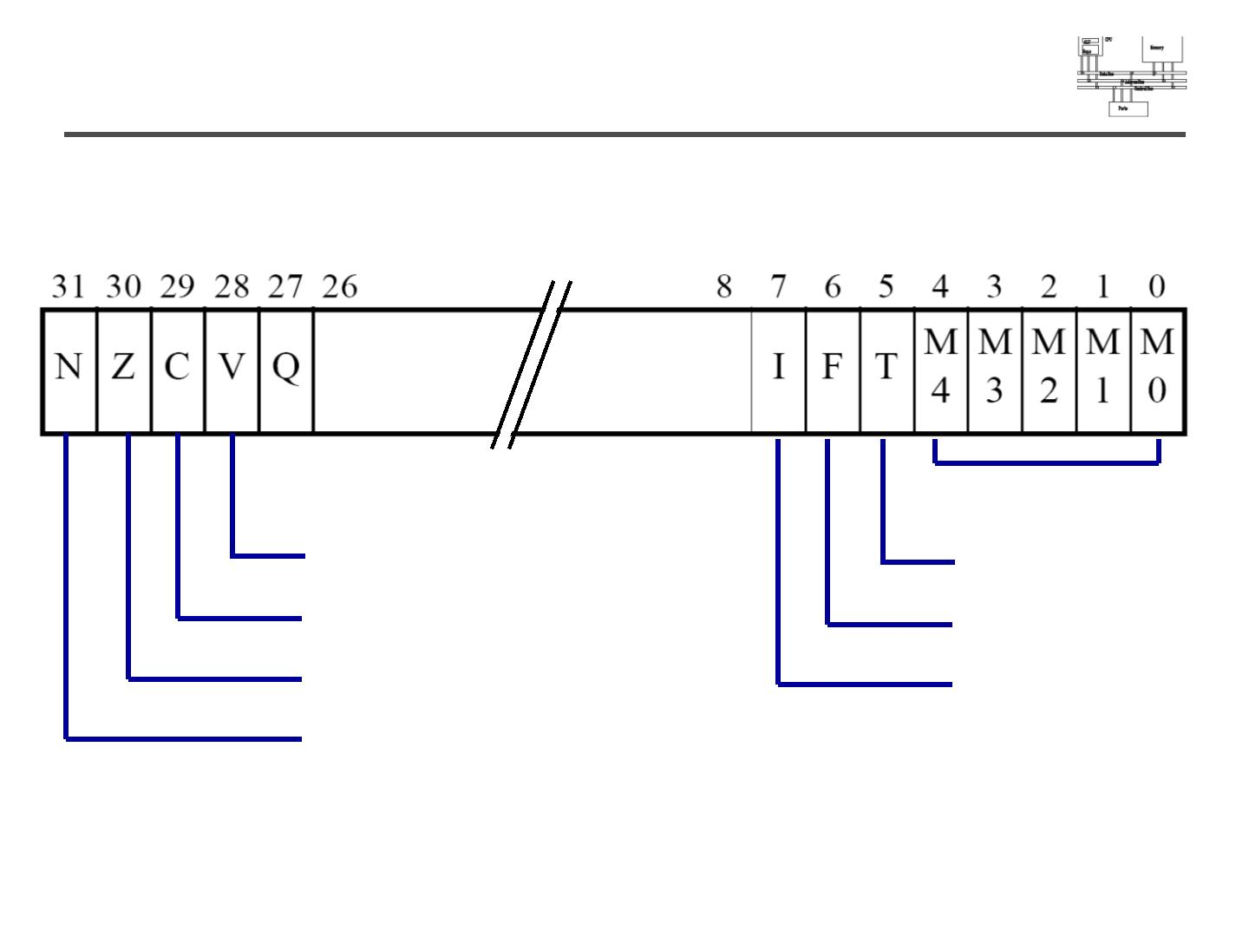
Program status register (CPSR)
mode bits
overflow
carry/borrow
zero
Thumb state
FIQ disable
IRQ disable
negative

Slide 21
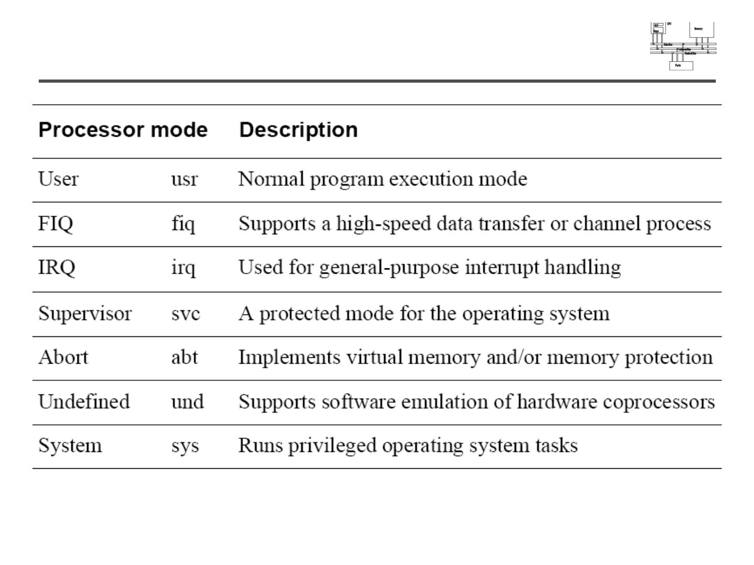
Processor modes

Slide 22
Processor Modes
The ARM has seven operating modes:
User mode is the usual ARM program execution state, and is used for executing most application programs.
Fast Interrupt (FIQ) mode supports a data transfer or channel process.
Interrupt (IRQ) mode is used for general-purpose interrupt handling.
Supervisor mode is a protected mode for the operating system.
Abort mode is entered after a data or instruction Prefetch Abort.
System mode is a privileged user mode for the operating system.
You can only enter System mode from another privileged mode by modifying the mode bit of the Current Program Status Register (CPSR).
Undefined mode is entered when an undefined instruction is executed.
Notes:
The Programmers Model can be split into two elements - first of all, the processor modes and secondly, the processor registers. So let’s start by looking at the modes.
Now the typical application will run in an unprivileged mode know as “User” mode, whereas the various exception types will be dealt with in one of the privileged modes : Fast Interrupt, Supervisor, Abort, Normal Interrupt and Undefined (and we will look at what causes each of the exceptions later on).
NB - spell out the word FIQ, otherwise you are saying something rude in German!
One question here is what is the difference between the privileged and unprivileged modes? Well in reality very little really - the ARM core has an output signal (nTRANS on ARM7TDMI, InTRANS, DnTRANS on 9, or encoded as part of HPROT or BPROT in AMBA) which indicates whether the current mode is privileged or unprivileged, and this can be used, for instance, by a memory controller to only allow IO access in a privileged mode. In addition some operations are only permitted in a privileged mode, such as directly changing the mode and enabling of interrupts.
All current ARM cores implement system mode (added in architecture v4). This is simply a privileged version of user mode. Important for re-entrant exceptions because no exceptions can cause system mode to be entered.

Slide 23
Processor operating states
The ARM7TDMI processor has two operating states:
ARM 32-bit, word-aligned ARM instructions are executed in this state.
Thumb 16-bit, halfword-aligned Thumb instructions are executed in this state.
In Thumb state, the Program Counter (PC) uses bit 1 to select between alternate halfwords.
Transition between ARM and Thumb states does not affect the processor mode or the register contents.

Slide 24
Switching state
The operating state of the ARM7TDMI core can be switched between ARM state and Thumb state using the BX instruction.
All exception handling is entered in ARM state.
If an exception occurs in Thumb state, the processor reverts to ARM state.
The transition back to Thumb state occurs automatically on return.
An exception handler can change to Thumb state but it must return to ARM state to enable the exception handler to terminate correctly.

Slide 25
Exception Handling
When an exception occurs, the ARM:
Copies CPSR into SPSR_<mode>
Sets appropriate CPSR bits:
Changes to ARM state
Changes to related mode
Disables IRQ
Disables FIQ (only on fast interrupts)
Stores the return address in LR_<mode>
Sets PC to vector address
To return, exception handler needs to:
Restore CPSR from SPSR_<mode>
Restore PC from LR_<mode>
(more about this later…)
This can only be done in ARM state.
0x1C
FIQ
0x18
IRQ
0x14
(Reserved)
0x10
Data Abort
0x0C
Prefetch Abort
0x08
Software Interrupt
0x04
Undefined Instruction
0x00
Reset
Vector Table
Notes:
Exception handling on the ARM is controlled through the use of an area of memory called the vector table. This lives (normally) at the bottom of the memory map from 0x0 to 0x1c. Within this table one word is allocated to each of the various exception types.
This word will contain some form of ARM instruction that should perform a branch. It does not contain an address.
Reset - executed on power on
Undef - when an invalid instruction reaches the execute stage of the pipeline
SWI - when a software interrupt instruction is executed
Prefetch - when an instruction is fetched from memory that is invalid for some reason, if it reaches the execute stage then this exception is taken
Data - if a load/store instruction tries to access an invalid memory location, then this exception is taken
IRQ - normal interrupt
FIQ - fast interrupt
When one of these exceptions is taken, the ARM goes through a low-overhead sequence of actions in order to invoke the appropriate exception handler. The current instruction is always allowed to complete (except in case of Reset).
IRQ is disabled on entry to all exceptions; FIQ is also disabled on entry to Reset and FIQ.

Slide 26
Registers
The ARM7TDMI processor has a total of 37 registers:
• 31 general-purpose 32-bit registers
• 6 status registers.
These registers are not all accessible at the same time.
The processor state and operating mode determine which registers are available to the programmer.

Slide 27
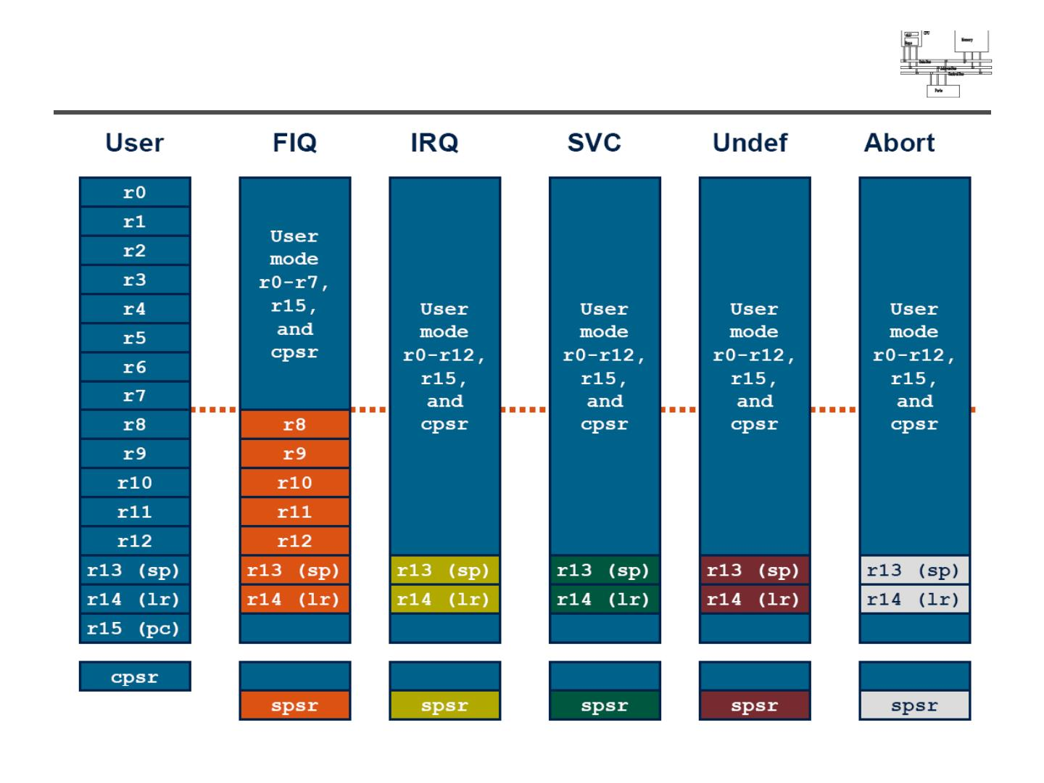
Register organization

Slide 28
The ARM-state register set contains 16 directly-accessible registers, r0 to r15.
CPSR, contains condition code flags and the current mode bits.
Registers r0 to r13 are general-purpose registers used to hold either data or address values.
Registers r14 and r15 have the following special functions:
Link register
Register r14 is used as the subroutine Link Register (LR).
Register r14 receives a copy of r15 when a Branch with Link (BL) instruction is executed.
At all other times you can treat r14 as a general-purpose register.
The corresponding banked registers r14_svc, r14_irq, r14_fiq, r14_abt and r14_und are similarly used to hold the return values of r15 when interrupts and exceptions arise, or when BL instructions are executed within interrupt or exception routines.
Program counter
Register r15 holds the PC.
In ARM state, bits [1:0] of r15 are undefined and must be ignored.
Bits [31:2] contain the PC.
In Thumb state, bit [0] is undefined and must be ignored. Bits [31:1] contain the PC.
By convention, r13 is used as the Stack Pointer (SP).

Slide 29
Program Counter (R15)
When the processor is executing in ARM state:
All instructions are 32 bits wide
All instructions must be word aligned
Therefore the PC value is stored in bits [31:2] and bits [1:0] are zero
Due to pipelining, the PC points 8 bytes ahead of the current instruction, or 12 bytes ahead if current instruction includes a register-specified shift
When the processor is executing in Thumb state:
All instructions are 16 bits wide
All instructions must be halfword aligned
Therefore the PC value is stored in bits [31:1] and bit [0] is zero
Notes:
ARM is designed to efficiently access memory using a single memory access cycle. So word accesses must be on a word address boundary, halfword accesses must be on a halfword address boundary. This includes instruction fetches.
Point out that strictly, the bottom bits of the PC simply do not exist within the ARM core - hence they are ‘undefined’. Memory system must ignore these for instruction fetches.
In Jazelle state, the processor doesn’t perform 8-bit fetches from memory. Instead it does aligned 32-bit fetches (4-byte prefetching) which is more efficient. Note we don’t mention the PC in Jazelle state because the ‘Jazelle PC’ is actually stored in r14 - this is technical detail that is not relevant as it is completely hidden by the Jazelle support code.

Slide 30
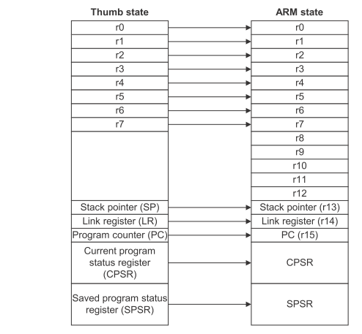

Slide 31
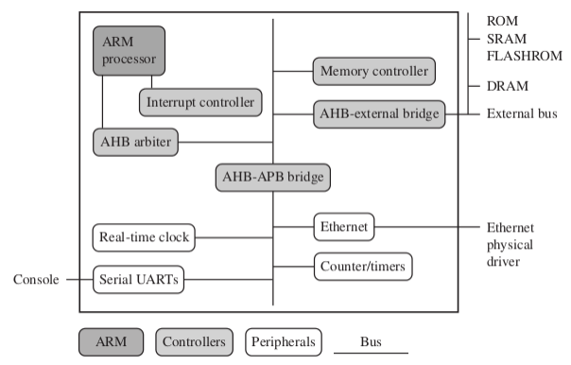
Embedded System Hardware

Slide 32
typical embedded device based on an ARM core
The embedded system hardware is divided into four main hardware components, they are
ARM processor: The ARM processor controls the embedded device. An ARM processor comprises a core plus the surrounding components that interface it with a bus. These components can include memory management and caches.
Controllers: Controllers coordinate important functional blocks of the system. Two commonly found controllers are interrupt controller and memory controller.
Peripherals: The peripherals provide all the input-output capability external to the chip and are responsible for the uniqueness of the embedded device.
Bus: A bus is used to communicate between different parts of the device.

Slide 33
ARM Bus Technology
Embedded systems use different bus technologies.
The most common PCI bus technology, the Peripheral Component Interconnect (PCI) bus, this type of technology is external or off-chip.
Embedded devices use an on-chip bus that is internal to the chip and that allows different peripheral devices to be interconnected with an ARM core.
There are two different classes of devices attached to the bus.
Bus master (ARM processor core)—a logical device capable of initiating a data transfer with another device across the same bus.
Bus slaves (Peripherals)—logical devices capable only of responding to a transfer request from a bus master device.

Slide 34

AMBA Bus Protocol
widely adopted as the on-chip bus architecture used for ARM processors.
It was introduced in 1996 and has been widely adopted as the on-chip architecture used for
ARM processors.
The first AMBA buses introduced were.
1. ARM System Bus (ASB)
2. ARM Peripheral Bus (APB).
Later ARM introduced another bus design,
3. ARM High Performance Bus (AHB).

Slide 35
ARM Bus
Centralized multiplexed provides higher data throughput rather than the ASB bidirectional bus design.
AHB runs at higher clock speed.
It supports widths of 64 and 128 bits.
ARM has introduced two variations on the AHB bus:
a. Multi-layer AHB: It’s a bus that allows multiple active bus masters.
b. AHB-Lite: It’s a subset of the AHB bus and it is limited to a single bus master.
The AHB and Multi-layer AHB support the same protocol for master and slave but have different interconnects. The new interconnects in multi-layer AHB are good for system with multiple processors. They permit operations to occur in parallel and allow for higher throughput rates.

Slide 36
Memory Controllers and Interrupt Controllers
Memory Controllers:
Connect different types of memory to the processor bus.
On power-up a memory controller is configured in hardware to allow certain memory devices to be active.
Some memory devices must be set up by software.
Interrupt Controllers:
An interrupt controller provides a programmable base that allows software to determine which peripheral or device can interrupt the processor at any specific time by setting the appropriate bits in the interrupt controller registers.
There are two types of interrupt controller available for the ARM processor:
Standard interrupt controller (SIC): The standard interrupt controller sends an interrupt signal to the processor core when an external device requests servicing.
The interrupt handler determines which device requires servicing by reading a device bitmap register in the interrupt controller.
Vector interrupt controller (VIC): The VIC is more powerful than the standard interrupt controller because it prioritizes interrupts.

Slide 37
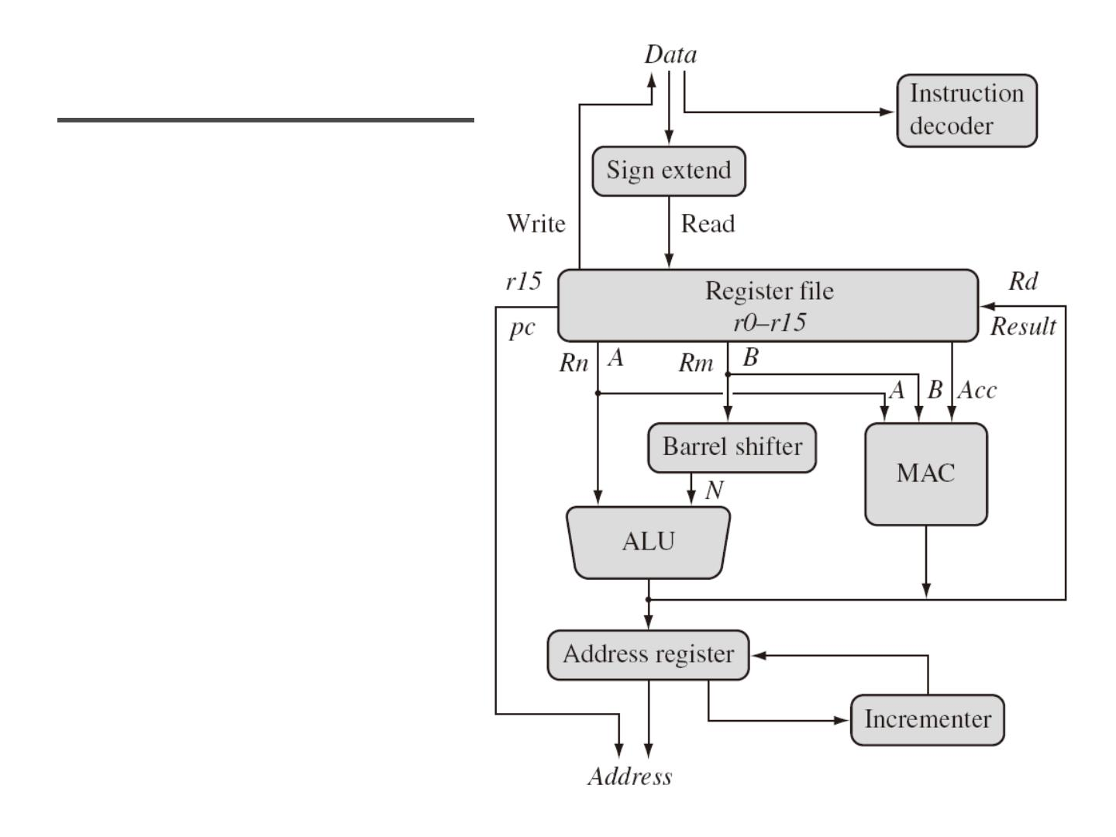
ARM core data flow model

Slide 38
Barrel shifter
The barrel shifter is a functional unit which can be used in a number of different circumstances.
It provides five types of shifts and rotates which can be applied to Operand2 to many ARM and Thumb data-processing and single register data-transfer instructions (These are not operations themselves in ARM mode.)
32-bit Thumb instructions give almost the same access to the barrel shifter as ARM instructions.
The 16-bit Thumb instructions only allow access to the barrel shifter using separate instructions.

Slide 39
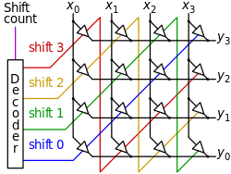

Slide 40
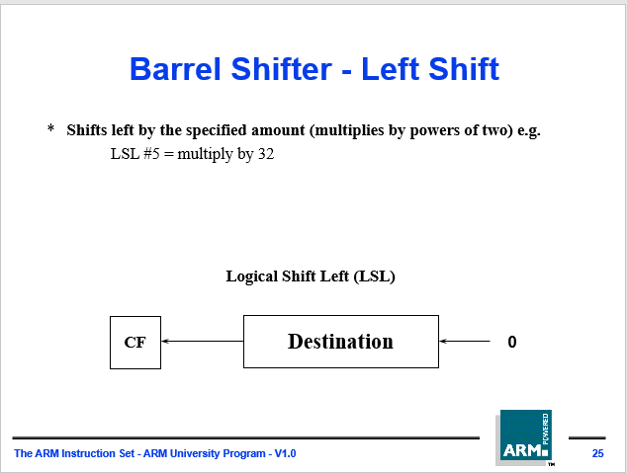

Slide 41
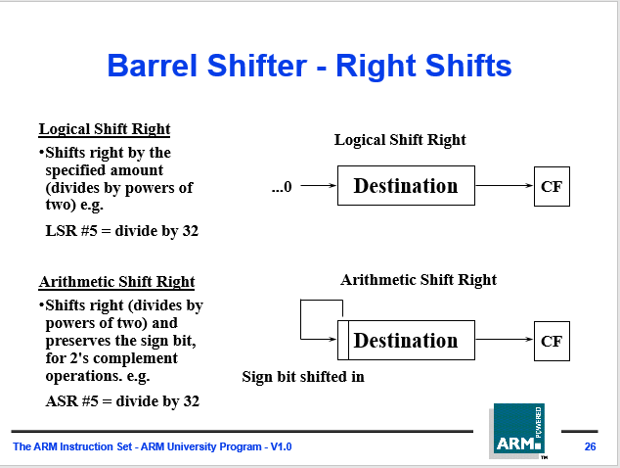

Slide 42
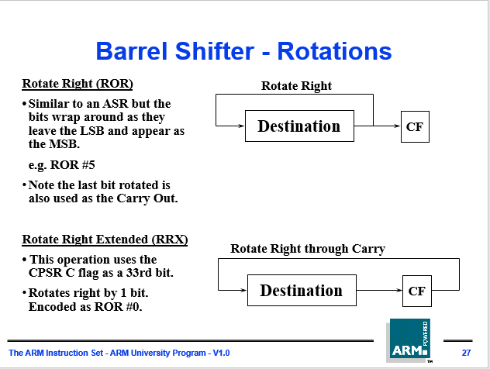

Slide 43
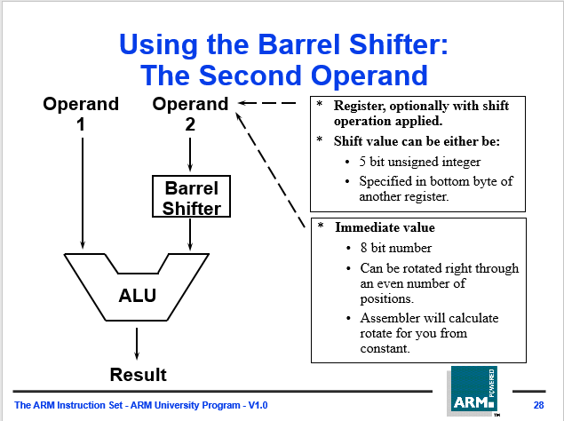

Slide 44
Operand 2 and the barrel shifter
The first operand for all data processing operations must always be a register.
The second operand is much more flexible and can be either
an immediate value (#x)
a register (Rm),
a register shifted by an immediate value
register "Rm, shift #x" or "Rm, shift Rs"
There are five shift operations: left shift (LSL), logical right-shift (LSR), arithmetic right-shift (ASR), rotate-right (ROR) and rotate-right extended (RRX).

Slide 45
ARM assembly language does not require explicit shift instructions.
Instead, the MOV instruction can be used for shifts and rotates.
R0 = R1 >> 2 is done as MOV R0, R1, LSR #2.
Equally, it is common to combine shifts with ADD, SUB or other instructions. For example, to multiply R0 by 5, you might write:
ADD R0, R0, R0, LSL #2
A left shift of n places is effectively a multiply by 2 to the power of n,
so this effectively makes R0 = R0 + (4 × R0).
A right shift provides the corresponding divide operation,
although ASR rounds negative values differently than would division in C
add R0, R1, R2, LSL #4 @ R0 = R1 + R2<<#4
add R0, R1, R2, LSL R3 @ R0 = R1 + R2<<R3

Slide 46
Examples of Barrel shifting
MOV r0, r0, LSL #1 Multiply R0 by two.
MOV r1, r1, LSR #2 Divide R1 by four (unsigned).
MOV r2, r2, ASR #2 Divide R2 by four (signed).
MOV r3, r3, ROR #16 Swap the top and bottom halves of R3.
ADD r4, r4, r4, LSL #4 Multiply R4 by 17. (N = N + N * 16)
RSB r5, r5, r5, LSL #5 Multiply R5 by 31. (N = N * 32 - N)
RSB r1, r2, r3; r1= r3-r2

Slide 47
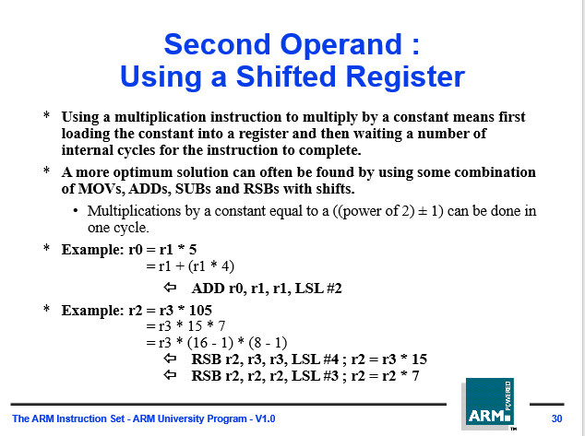

Slide 48
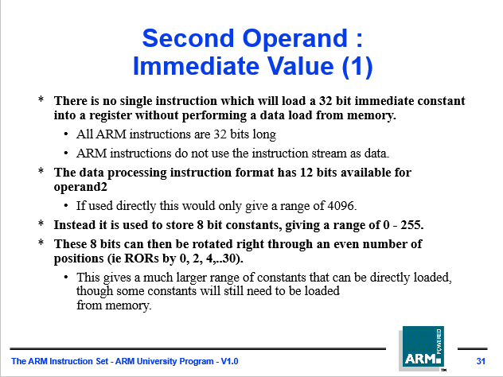

Slide 49
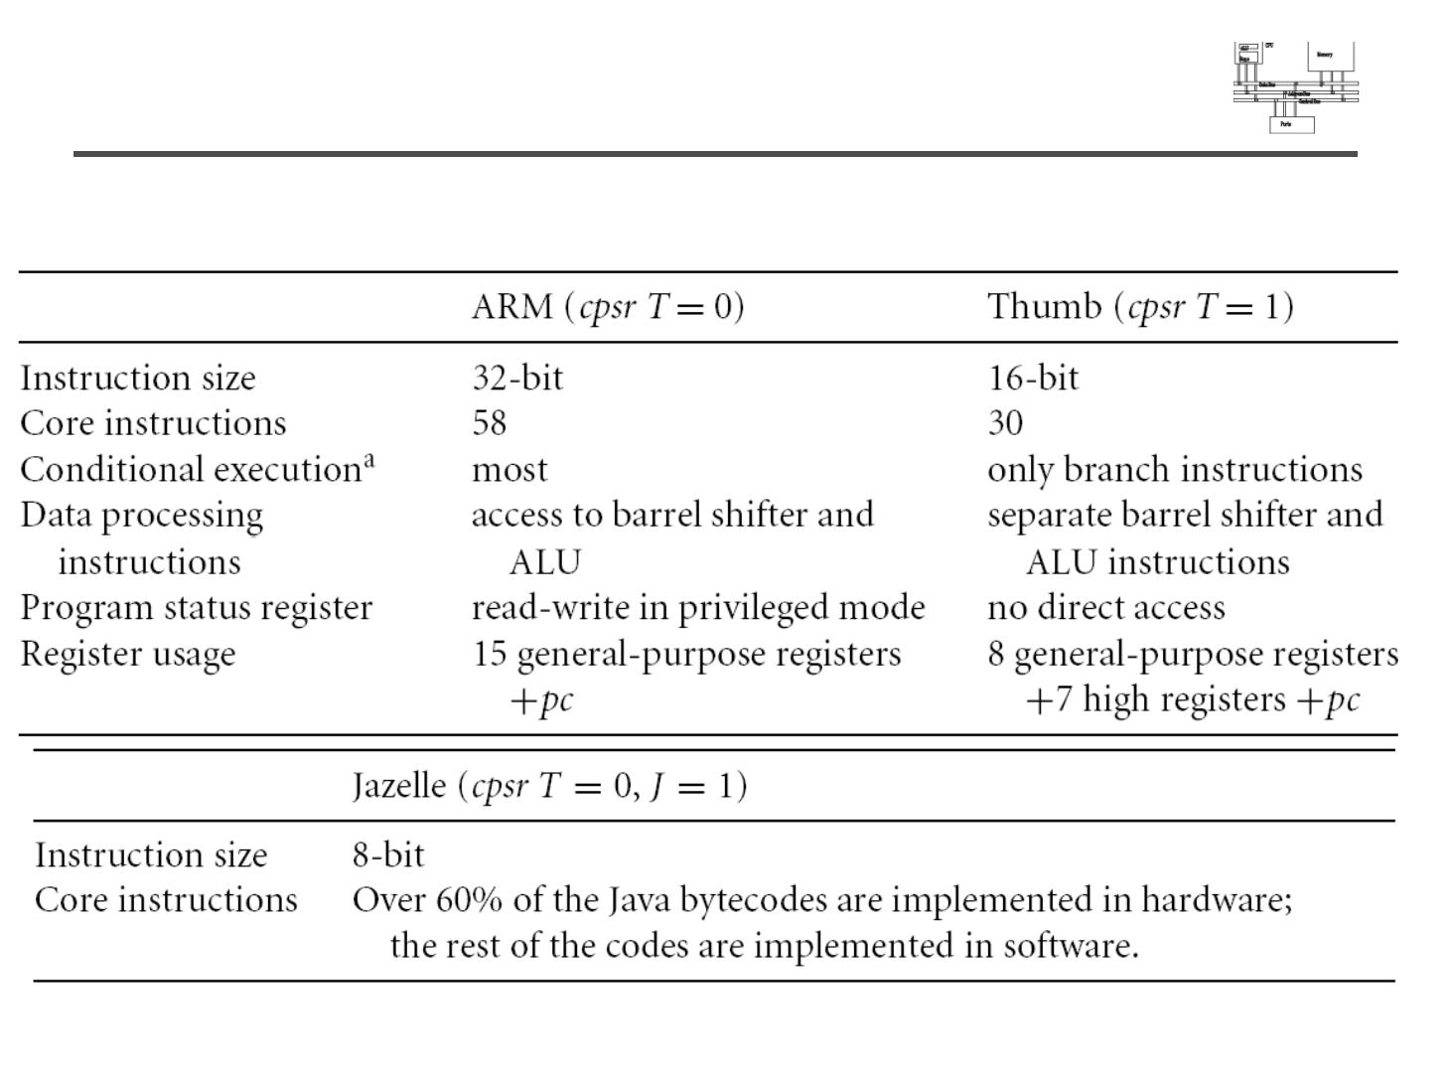
Instruction sets
• ARM/Thumb/Jazelle

Slide 50
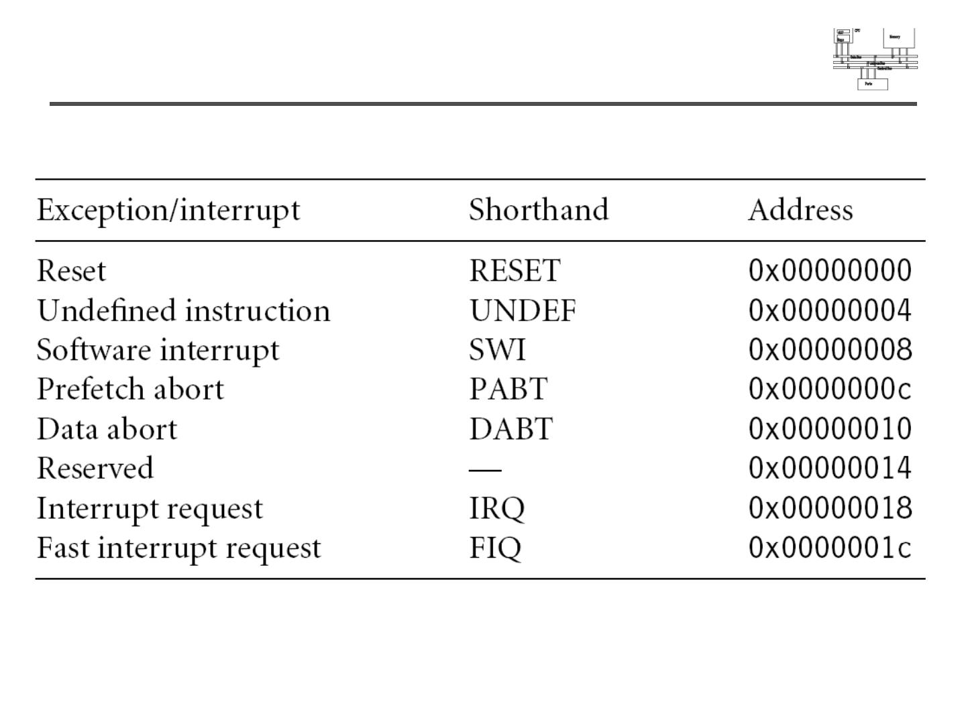
Interrupts

Slide 51
Priorities and exceptions
Breakpoint with Prefetch Abort
When a breakpointed instruction fetch causes a Prefetch Abort, the abort is taken and the breakpoint is disregarded.
Usually, Prefetch Aborts occur when, for example, an access is made to a virtual address that does not physically exist and the returned data is therefore invalid.
In such a case, the normal action of the operating system is to swap in the page of memory and to return to the previously-invalid address.
This time, when the instruction is fetched and providing the breakpoint is activated, it can be data-dependent, the ARM7TDMI core enters debug state.
The Prefetch Abort, therefore, takes higher priority than the breakpoint.

Slide 52
Prefetch abort
When a prefetch abort occurs, the processor marks the prefetched instruction as invalid, but does not take the exception until it executes the instruction.
If the processor does not execute the instruction, for example because a branch occurs while it is in the pipeline, the abort does not take place.
After dealing with the cause of the abort, the handler executes the following instruction irrespective of the processor operating state:
SUBS PC,R14_abt,#4
This action restores both the PC and the CPSR, and retries the aborted instruction.

Slide 53
Interrupts
When the ARM7TDMI core enters halt debug state, interrupts are automatically disabled.
If an interrupt is pending during the instruction prior to entering debug state, the ARM7TDMI core enters debug state in the mode of the interrupt.
On entry to debug state, the debugger cannot assume that the ARM7TDMI core is in the mode expected by the user program.
The debugger must check the PC, the CPSR, and the SPSR to accurately determine the reason for the exception.
Debug, therefore, takes higher priority than the interrupt, but the ARM7TDMI core does remember that an interrupt has occurred.

Slide 54
Data Aborts
When a Data Abort occurs on a watchpointed access, the ARM7TDMI core enters debug state in abort mode.
The watchpoint, therefore, has higher priority than the abort, but the ARM7TDMI core remembers that the abort happened.

